Slide 1
New York Airbnb Pricing and COVID-19
ITEC-621

Slide 2
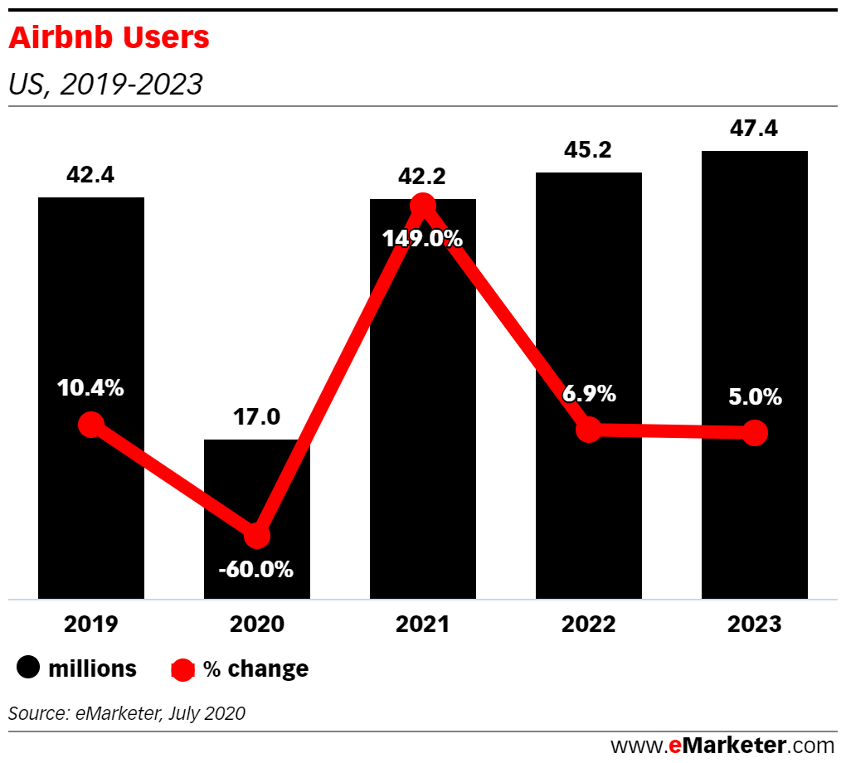
Business Case + Question
Massive reduction in rentals during COVID
Renters will need to match demand while maximizing revenue
High amount of forecasted rentals

Slide 3


Analytics Question + Analytic Goals
Analytics Goal: Predictive Accuracy < Interpretation
Variable Categories: Binary, Quantitative, Categorical
Predictors: COVID Case Count, Amenities, # of Beds
Outcome Variable: Price
Question: What main factors drive Airbnb prices?
Notes:
Outcome Variable
Type of question
Main predictors

Slide 4
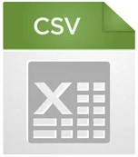
Project Data Set
“Airbnb US Dataset” from Kaggle.com
Cleaning Data Set
Removed different cities, unusable variables, and incomplete rows
Data Dimensions
 | Original | Only NY | NY Data+COVID
Variables | 28 | 19 | 37
Observations | 158,250 | 36,900 | 24,029

Slide 5
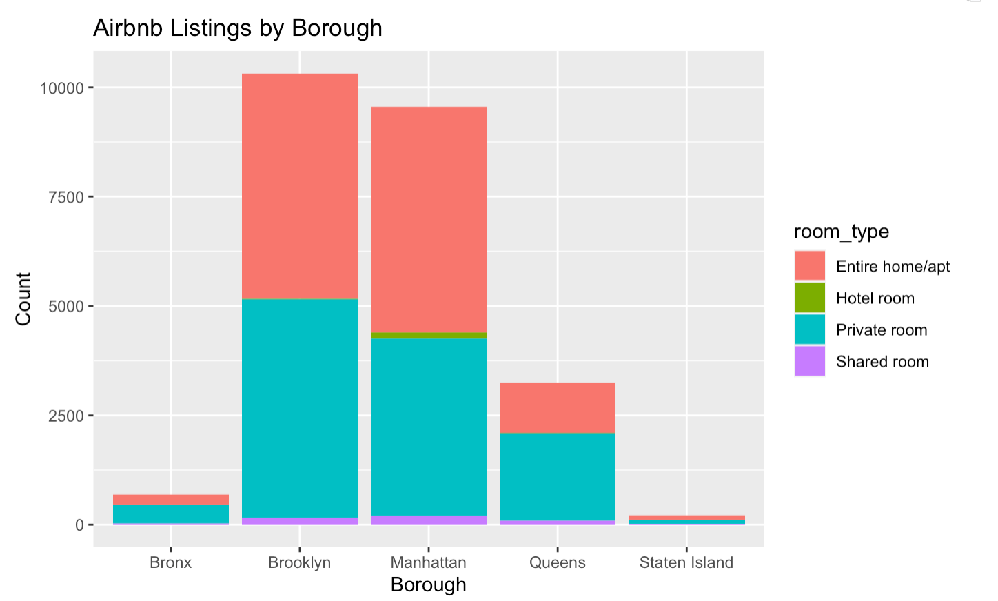
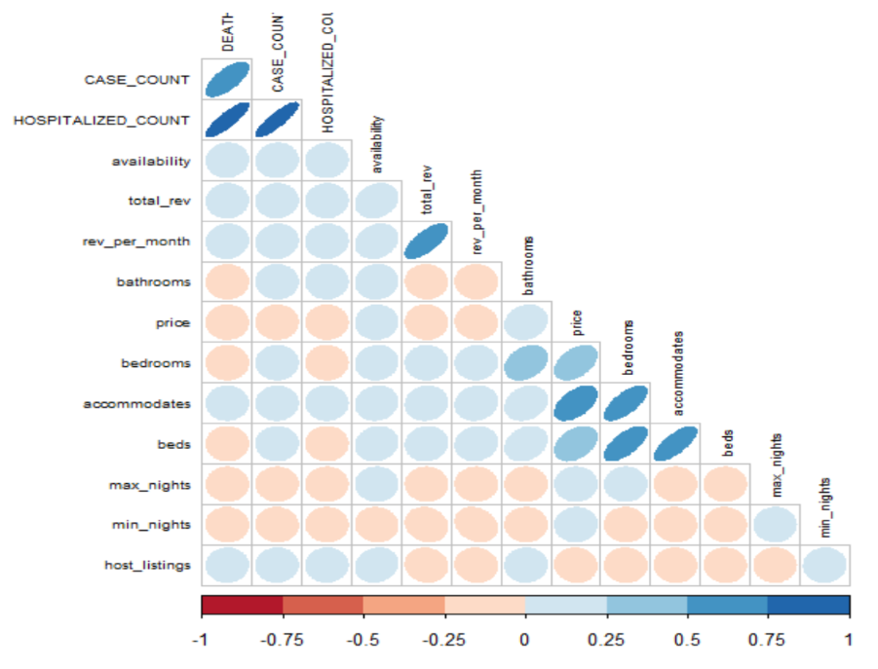
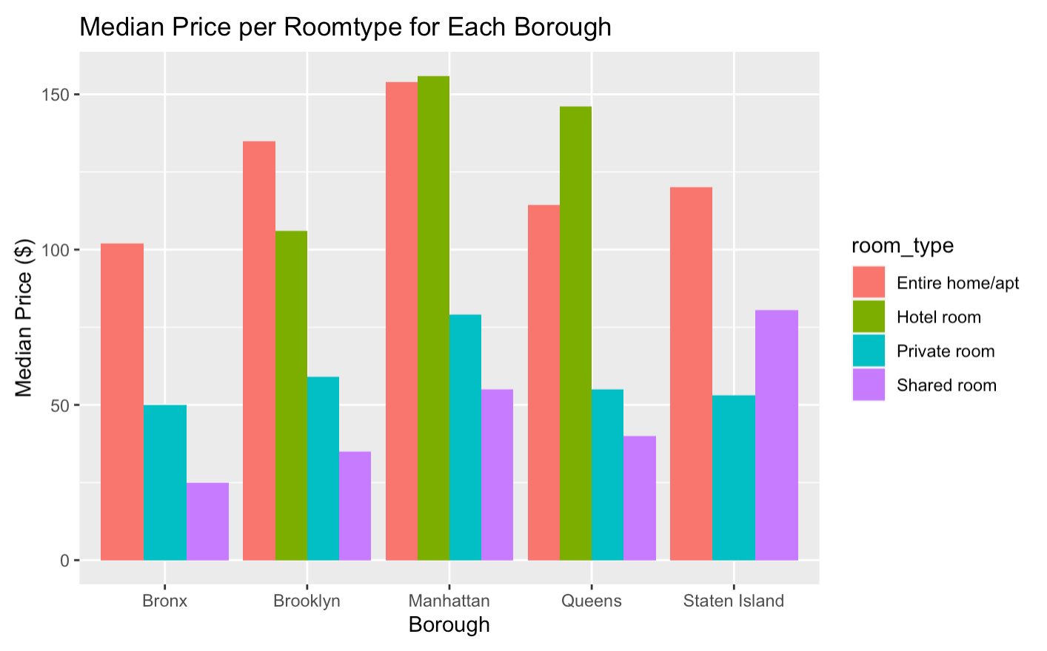
Descriptive Statistics/ Analytics

Slide 6
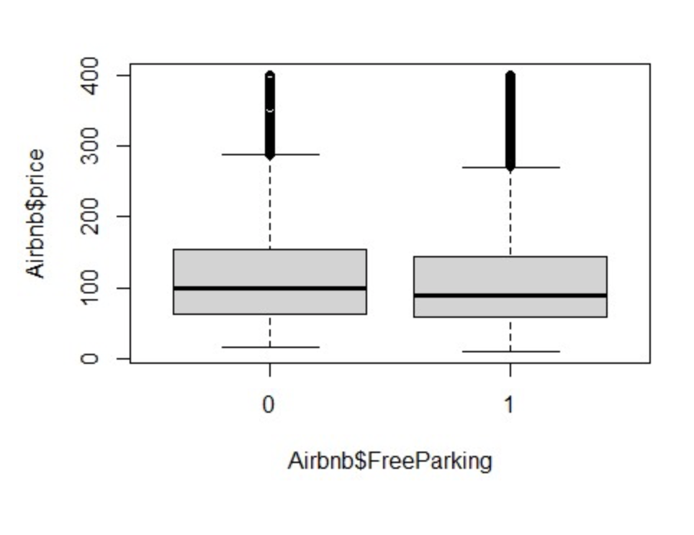
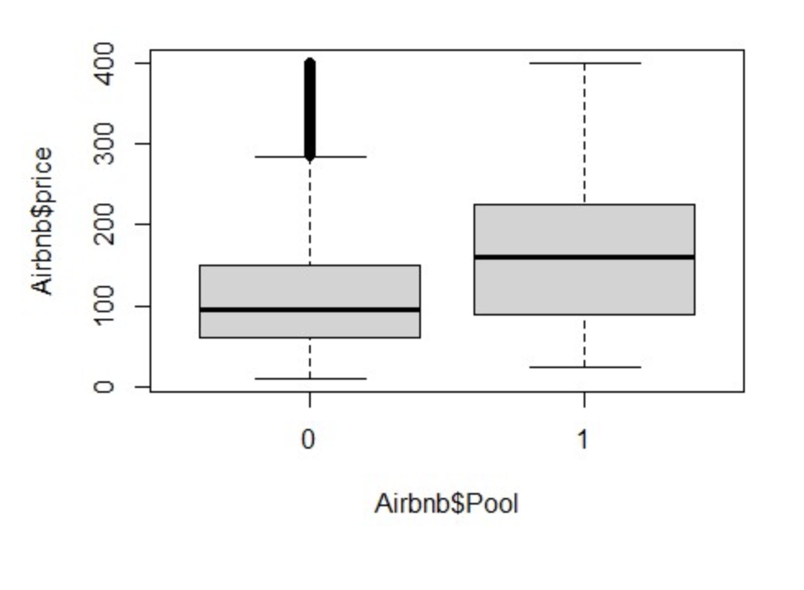
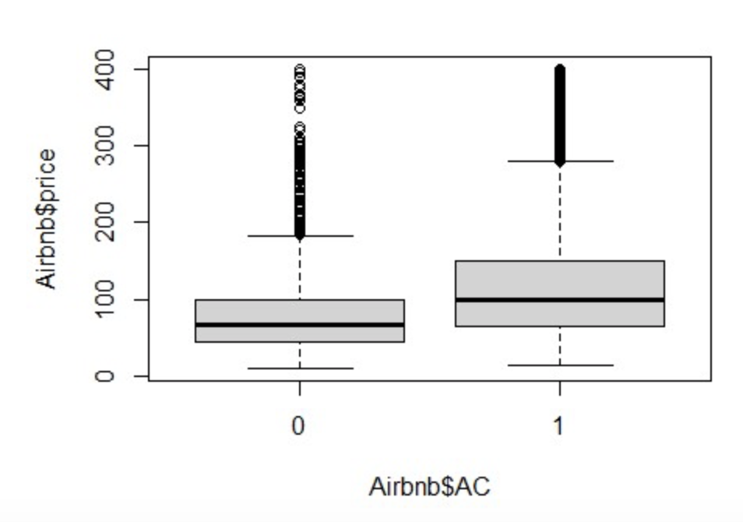
Descriptive Statistics/ Analytics

Slide 7
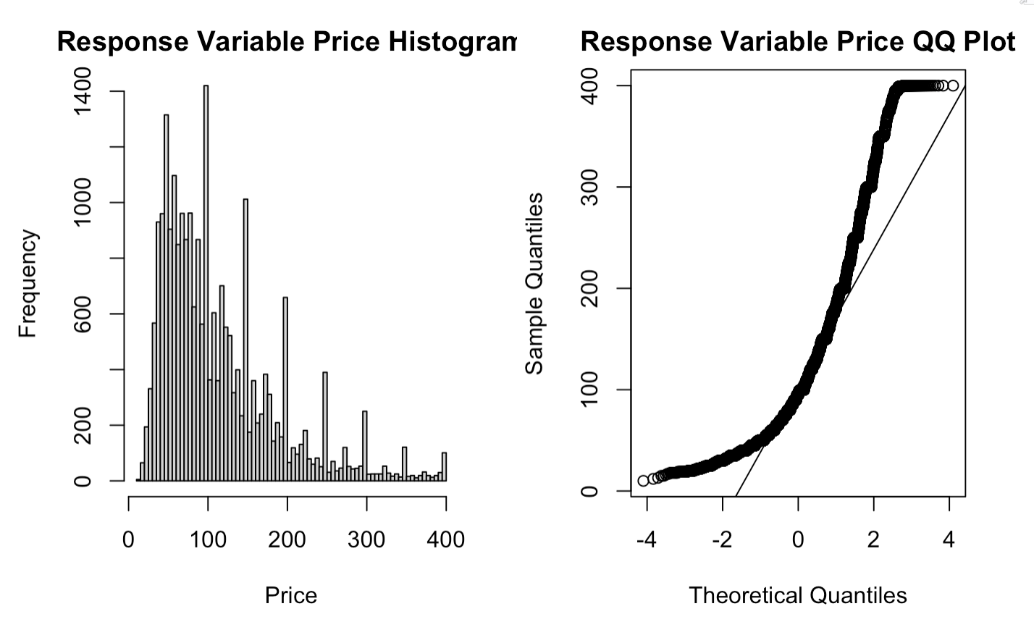
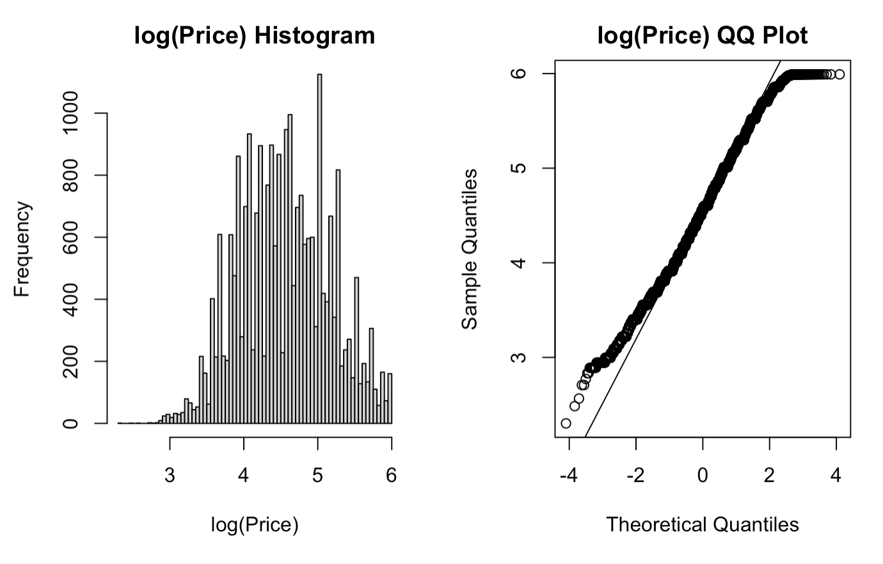
Descriptive Statistics/ Analytics
Our dependent variable had significant skewness
Logging normalized the dependent variable to an acceptable level

Slide 8
Modeling Methods & Specifications
price(Quantitative)
Specification 2
Specification 1
Statistical predictors (small)
OLS
Business predictors (initial)
Assumptions testing
Assumptions testing
Log-linear WLS
CI=29
CI=44
Model 1
Ridge
Weighted Ridge
Random Forest
Model 2
Model 2 with weights
Model 3
8 combinations

Slide 9
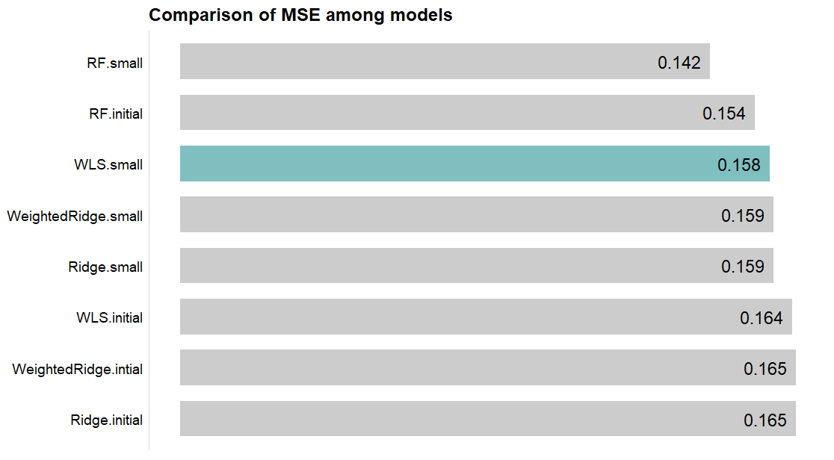
Modeling Methods & Specifications
/10-Fold CV
MSE increases

Slide 10
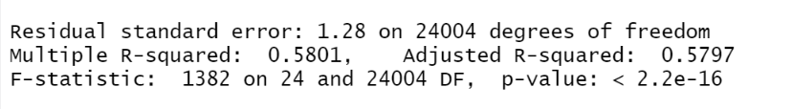
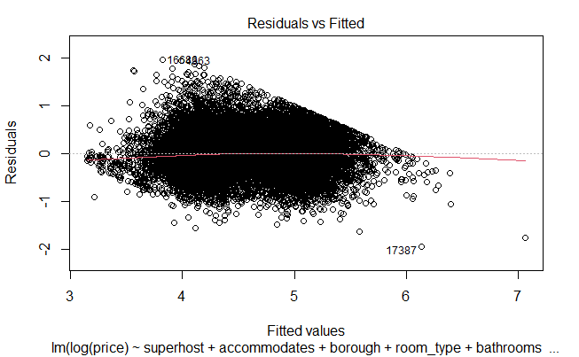
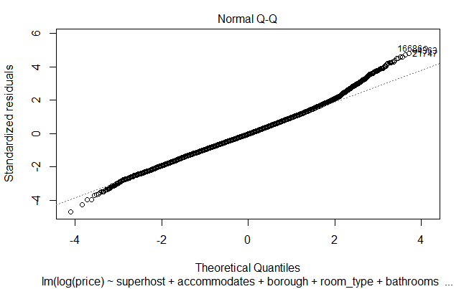
Analysis of Results

Slide 11
Analysis of Results (Categoricals)
Borough Categorical Variable
 | Manhattan | Brooklyn | Queens | Staten Island
Effect size (%) | +41.2% | +19.1% | +10% | +0.2%
Compared to the Bronx (Lowest median and average price)
Not significant
Room Type Categorical Variable
 | Private room | Shared room | Hotel room
Effect size (%) | -54.5% | -86.1% | -4.4%
Compared to Entire Homes (Most popular and sought-after)
Not significant

Slide 12
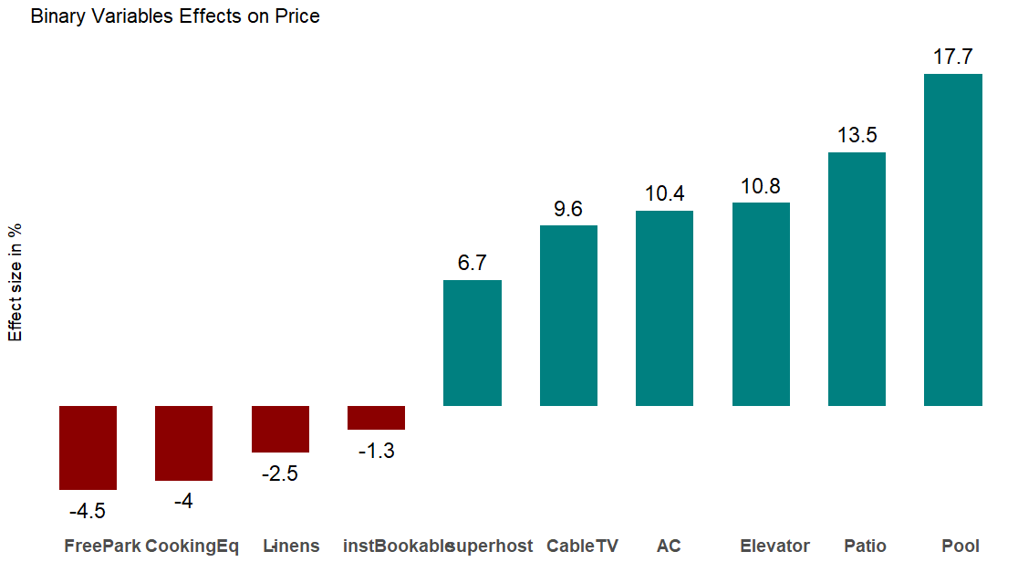
Analysis of Results (Binaries)

Slide 13
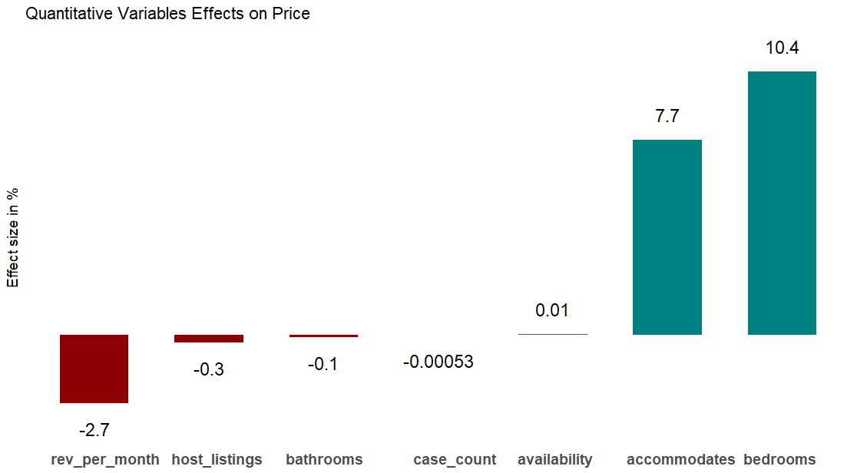
Analysis of Results (Quantitative)
Covid cases effect

Slide 14
Conclusions
If you are an Airbnb renter in NY, here’s what drives your price:
Location (borough, namely Manhattan and Brooklyn)
Privacy of location, number of bedrooms, guests
Your reputation
Nice-to-have amenities (AC, pool, patio, etc.)
COVID cases a non-factor, but useful information
Important in COVID context: list price vs. rent price/frequency
Helpful for renters: explains how similar units price
Notes:
Once we landed on our data set,

Slide 15
Challenges and Lessons Learned
Lack of precise rental dates beyond last_review
Time organizing, cleaning dates and amenities
Random forest computing requirements
Lesson: Results, COVID-19 insights still meaningful
Ideal: Airbnb rentals (by location, by day, rent price and frequency) to examine true effects of COVID

Slide 16



Questions?

